Slide 1
Collections Data Types
Lecturer: SO Vengleab
Date: July 2026

Slide 2
What is Collections?
Collections store groups of multiple values or objects, where as primitive types store a single, basic value
List
Tuple
Dictionary
Set
[ ]
Ordered, mutable sequence of items. Allows duplicates.
( )
Ordered, immutable sequence. Faster & hashable.
{ : }
Key-value pairs, unordered (3.7+ ordered), mutable.
{ }
Unordered, unique elements. Fast membership testing.

Slide 3
List

Slide 4
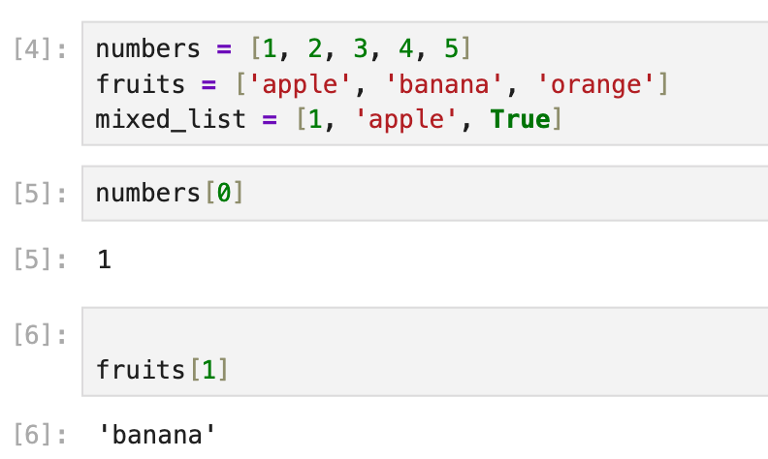
List
Ordered items
Different data types within same list
Mutable (can be modified).
Indexed access
Notes:
numbers = [1, 2, 3, 4, 5]
fruits = ['apple', 'banana', 'orange']
mixed_list = [1, 'apple', True]
numbers[0] # 1
fruits[1] # 'banana'

Slide 5
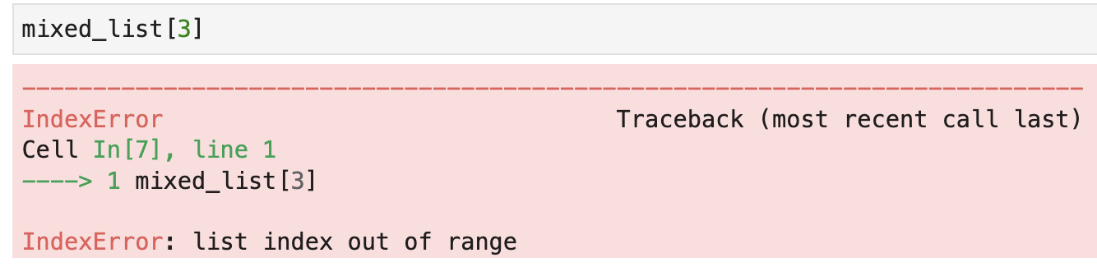
Access by index
Access index out of range
Notes:
numbers = [1, 2, 3, 4, 5]
fruits = ['apple', 'banana', 'orange']
mixed_list = [1, 'apple', True]
numbers[0] # 1
fruits[1] # 'banana'
mixed_list = [1, 'apple', True]
mixed_list[3]
# raises IndexError: list index out of range

Slide 6
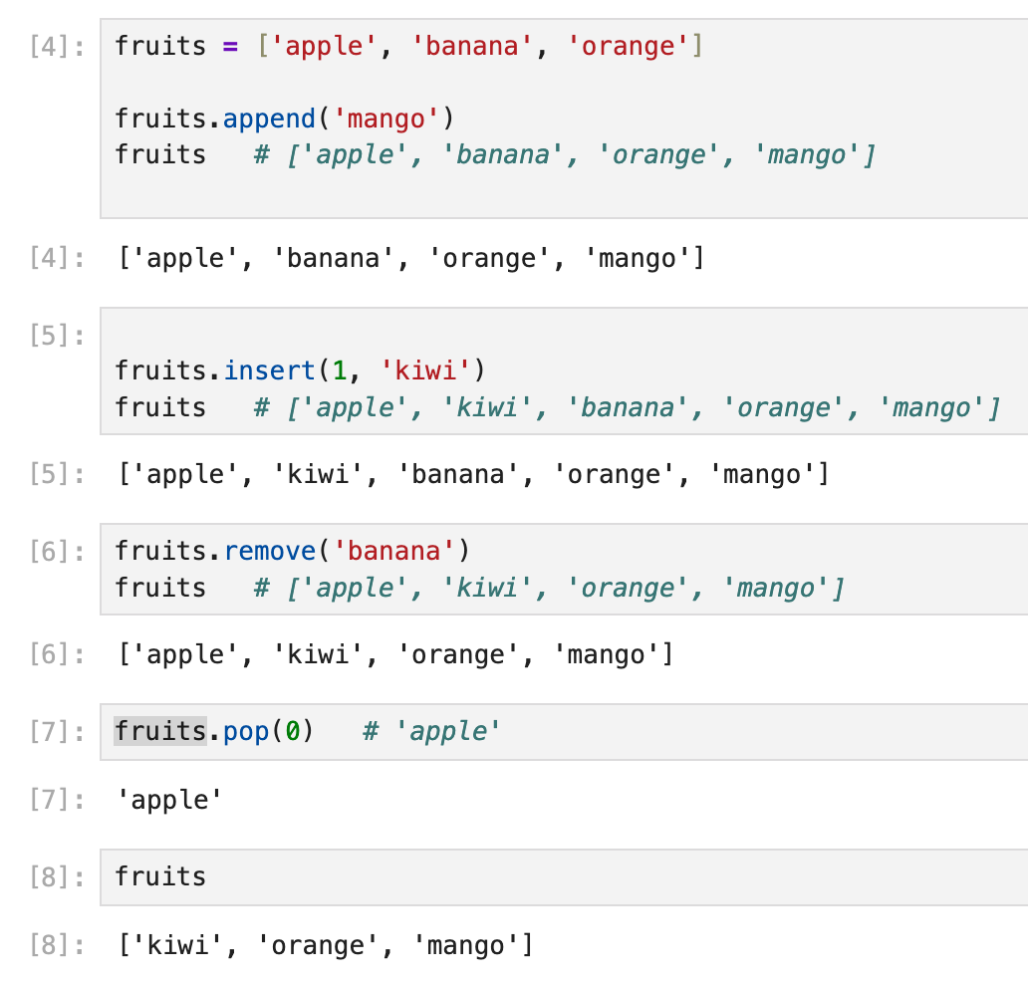
Common List Methods
.append(x)
Add x to end
.insert(i,x)
Insert x at index i
.remove(x)
Remove first x
.pop(i)
Remove & return item at i
Notes:
fruits = ['apple', 'banana', 'orange']
fruits.append('mango')
fruits # ['apple', 'banana', 'orange', 'mango']
fruits.insert(1, 'kiwi')
fruits # ['apple', 'kiwi', 'banana', 'orange', 'mango']
fruits.remove('banana')
fruits # ['apple', 'kiwi', 'orange', 'mango']
fruits.pop(0) # 'apple'

Slide 7
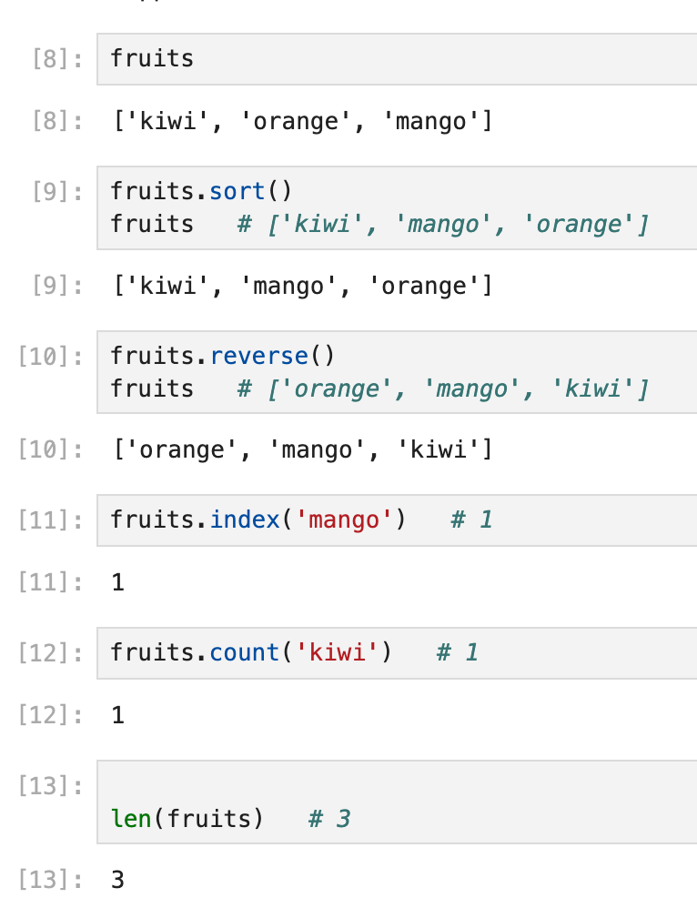
Extra List Methods
.sort()
Sort in-place
.reverse()
Reverse in-place
.index(x)
Index of first x
.count(x)
Count occurrences of x
Notes:
fruits.sort()
fruits # ['kiwi', 'mango', 'orange']
fruits.reverse()
fruits # ['orange', 'mango', 'kiwi']
fruits.index('mango') # 1
fruits.count('kiwi') # 1
len(fruits) # 3

Slide 8
Dictionary

Slide 9
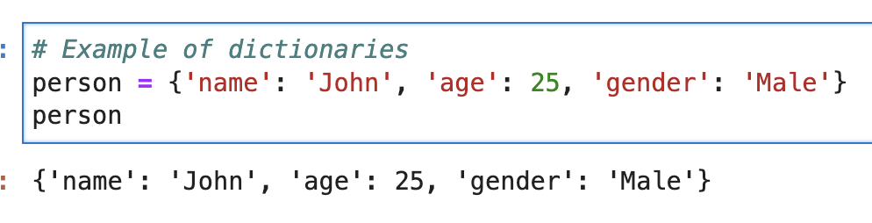
Dictionaries
Key-value pairs used to store data.
Mutable and unordered.
https://www.w3schools.com/python/python_dictionaries_methods.asp
Notes:
# Example of dictionaries
person = {'name': 'John', 'age': 25, 'gender': 'Male'}
person # {'name': 'John', 'age': 25, 'gender': 'Male'}

Slide 10
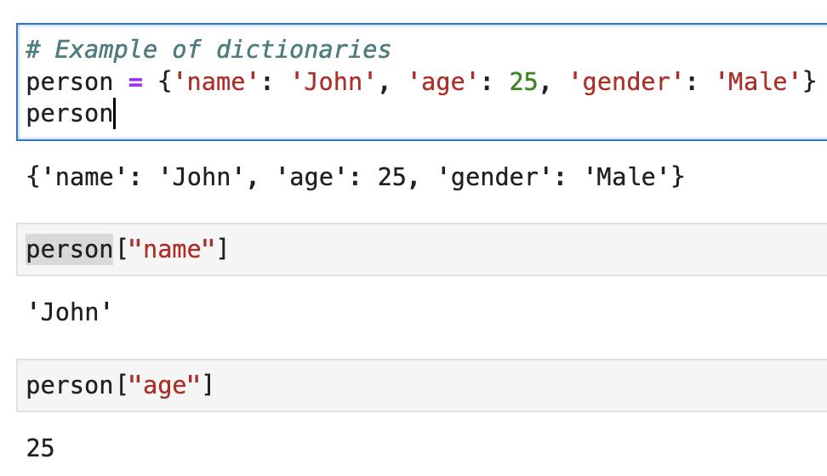
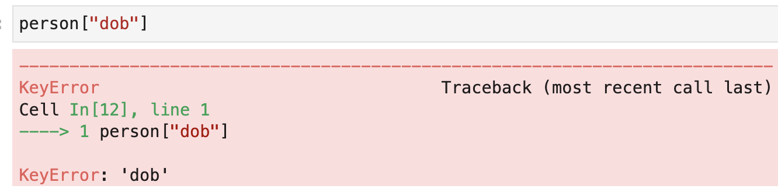
Access by key
Access by wrong key
Notes:
# Example of dictionaries
person = {'name': 'John', 'age': 25, 'gender': 'Male'}
person # {'name': 'John', 'age': 25, 'gender': 'Male'}
person["name"] # 'John'
person["age"] # 25
person = {'name': 'John', 'age': 25, 'gender': 'Male'}
person["dob"]
# raises KeyError: 'dob'

Slide 11
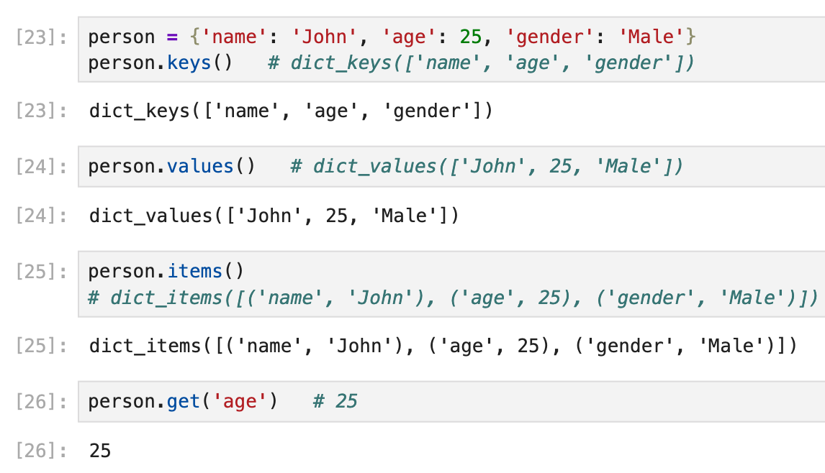
Common Dict methods for read data
.keys()
Returns a view object of all keys
.values()
Returns a view object of all values
.get(key)
Returns value of key (safe access)
.items()
Returns view of key-value pairs
Notes:
person = {'name': 'John', 'age': 25, 'gender': 'Male'}
person.keys() # dict_keys(['name', 'age', 'gender'])
person.values() # dict_values(['John', 25, 'Male'])
person.items() # dict_items([('name', 'John'), ('age', 25), ('gender', 'Male')])
person.get('age') # 25

Slide 12
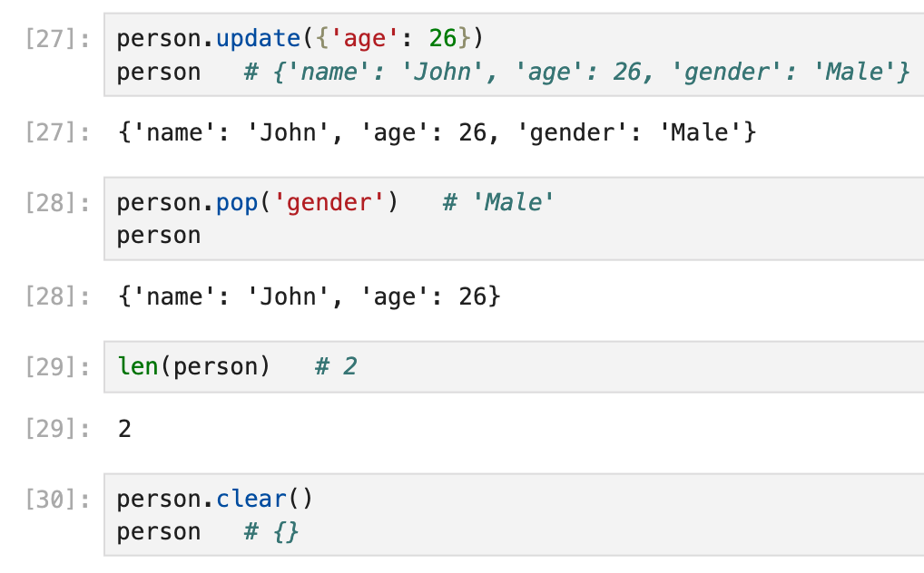
Common Dict method for change data
.update(obj)
Merge keys from another dict
.pop(key)
Removes and returns item at key
.clear()
Removes all elements from dict
Notes:
person.update({'age': 26})
person # {'name': 'John', 'age': 26, 'gender': 'Male'}
person.pop('gender') # 'Male'
len(person) # 2
person.clear()
person # {}

Slide 13
Tuple

Slide 14
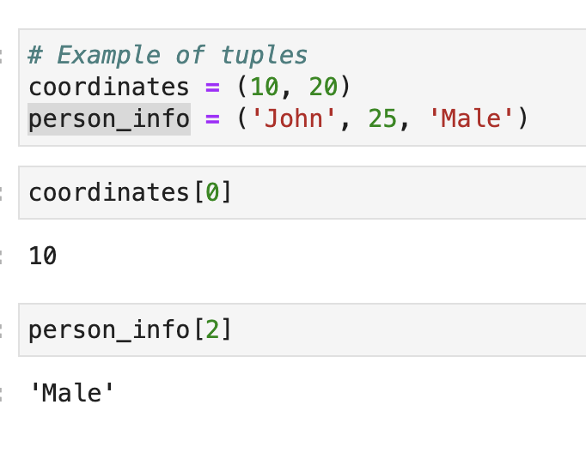
Tuple
Similar to lists but immutable (cannot be modified).
Typically used to store related pieces of information together.
Notes:
# Example of tuples
coordinates = (10, 20)
person_info = ('John', 25, 'Male')
coordinates[0] # 10
person_info[2] # 'Male'

Slide 15
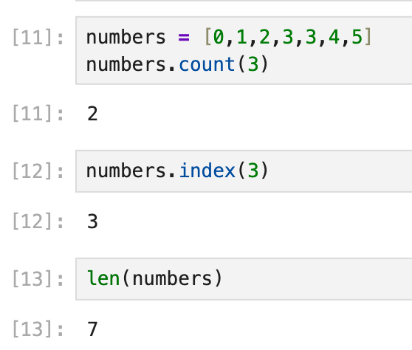
Common Tuple Methods
.count(x)
Returns the number of times a specified value occurs in a tuple
]
.index(x)
Searches the tuple for a specified value and returns the position of where it was found
len(tuple)
Returns the number of items in the tuple

Slide 16
Set

Slide 17
Sets
Unordered collection
Unique items.
Mutable items, but elements must be immutable(hashable ).
https://www.w3schools.com/python/python_sets.asp

Slide 18
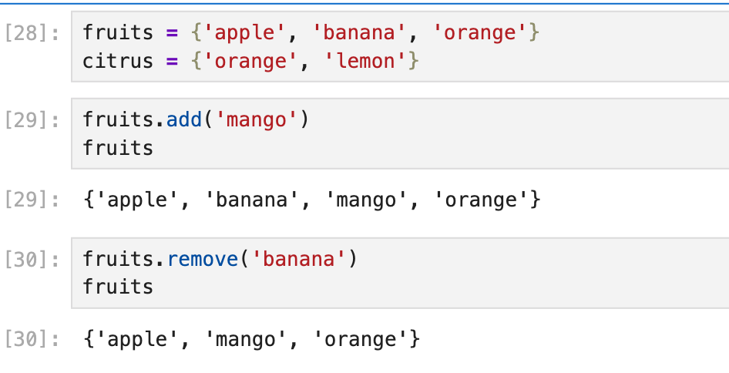
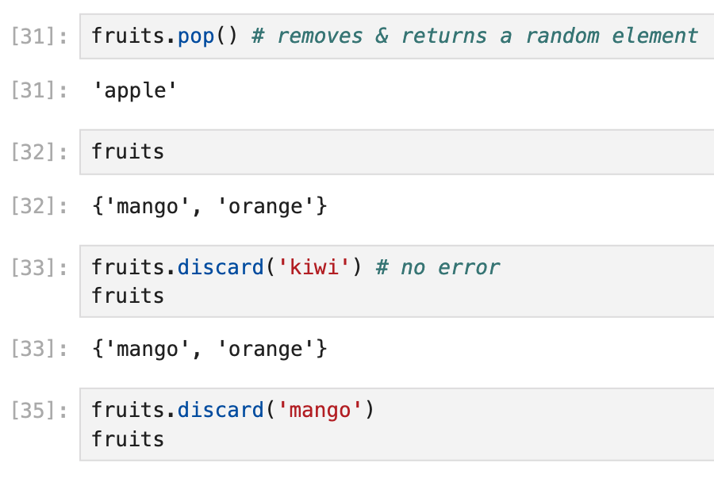
Common Set Methods
.add(x)
Add element x to the set
.remove(x)
Remove x; raises error if not present
.discard(x)
Remove x if present; no error if missing
.pop()
Remove and return a random element
Notes:
fruits = {'apple', 'banana', 'orange'}
citrus = {'orange', 'lemon'}
fruits.add('mango')
fruits # {'apple', 'banana', 'orange', 'mango'}
fruits.remove('banana')
fruits # {'apple', 'orange', 'mango'}
fruits.discard('kiwi')
fruits # {'apple', 'orange', 'mango'} # no error
fruits.pop() # # removes & returns a random element

Slide 19
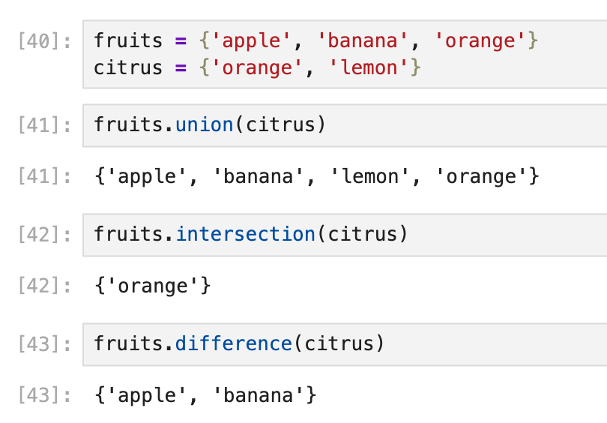
Common Set Methods
.difference(s)
Return elements in this set but not in s
.intersection(s)
Return intersection as a new set
.union(s)
Return union of sets as a new set
18
Notes:
fruits.union(citrus) # {'apple', 'orange', 'mango', 'lemon'}
fruits.intersection(citrus) # {'orange'}
fruits.difference(citrus) # {'apple', 'mango'}
len(fruits) # 3

Slide 20
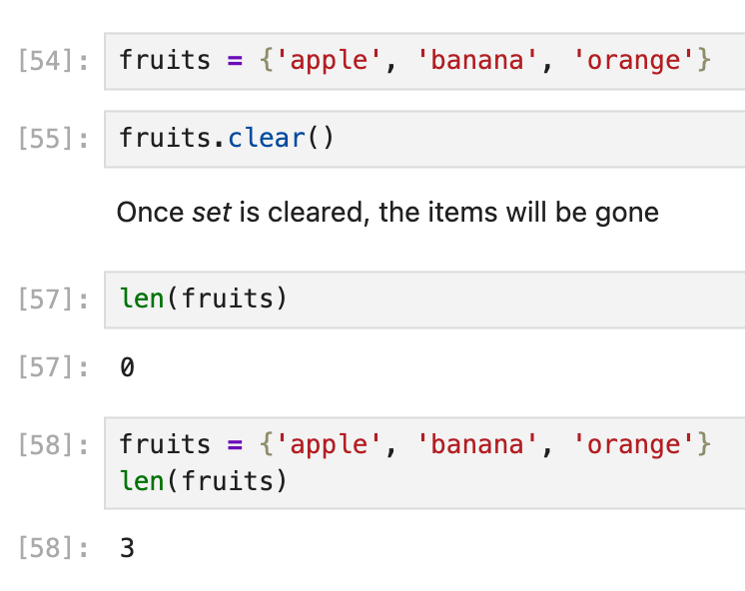
Common Set Methods
.clear()
Remove all elements from the set
len(set)
Return the number of elements

Slide 21
Practice - Foundation

Slide 22

List Practice
Create: a list of 3 elements: bread, milk, eggs
Append 'butter' to the end of the list.
Insert 'cheese' at index 1.
Remove 'bread' from the list.
Sort the list alphabetically.
Print
The list
and length of the list using len().
Expected result:
[1]: ['butter', 'cheese', 'eggs', 'milk']
[2]: (length 4)
Notes:
Solution:
groceries = ['bread', 'milk', 'eggs']
groceries.append('butter')
groceries.insert(1, 'cheese')
groceries.remove('bread')
groceries.sort()
len(groceries) # 4
# final: ['butter', 'cheese', 'eggs', 'milk']

Slide 23
Dictionary Practice
Create dictionary of {'title': 'Dune', 'author': 'Frank Herbert', 'year': 1965}
Access the author using book['author'].
Add a new key 'genre' with the value 'Sci-Fi'.
Update the year to 2021 .
Print: the dict.
Print .keys() and .values().
Remove the 'year' key.
Print the dict again
Expected result:
[1] {'title': 'Dune', 'author': 'Frank Herbert', 'year': 2021, 'genre': 'Sci-Fi'}
[2] dict_keys(['title', 'author', 'year', 'genre'])
[3] dict_values(['Dune', 'Frank Herbert', 2021, 'Sci-Fi'])
[4] {'title': 'Dune', 'author': 'Frank Herbert', 'genre': 'Sci-Fi'}
Notes:
Solution:
book = {'title': 'Dune', 'author': 'Frank Herbert', 'year': 1965}
book['author'] # 'Frank Herbert'
book['genre'] = 'Sci-Fi'
book.update({'year': 2021})
book.keys()
book.values()
book.pop('genre')
# final: {'title': 'Dune', 'author': 'Frank Herbert', 'year': 2021}

Slide 24
Tuple Practice
Access the second movie using movies[1].
Count how many times 'Inception' appears using .count().
Find the index of 'Avatar' using .index().
Print the length using len().
Expected result:
[1] 2 # count of inception
[2] 3 # Index of avatar
[3] 4 # Length of movies
Notes:
Solution:
movies = ('Inception', 'Titanic', 'Inception', 'Avatar')
movies[1] # 'Titanic'
movies.count('Inception') # 2
movies.index('Avatar') # 3
len(movies) # 4

Slide 25

Set Practice
Add 'orange' to your_fruits.
Find the union of your_fruits and friend_fruits, and print it.
Find the intersection (fruits you both like).
Find the difference (fruits only you like).
Print the length of your_fruits using len().
Expected result:
[1] {'orange', 'banana', 'grape', 'kiwi', 'mango', 'apple'} # union
[2] {'banana'} # intersect
[3] {'apple','mango','orange'} # different
[4] 4 # Length of your_fruits
Notes:
Solution:
your_fruits = {'apple', 'banana', 'mango'}
friend_fruits = {'banana', 'kiwi', 'grape'}
your_fruits.add('orange')
your_fruits.union(friend_fruits)
your_fruits.intersection(friend_fruits) # {'banana'}
your_fruits.difference(friend_fruits) # {'apple', 'mango', 'orange'}
len(your_fruits) # 4

Slide 26
Practice - Basic Collection Methods

Slide 27
Practice - Basic Collection Methods
1
Grocery List Basics
2
Reversing & Sorting
Append 'butter'; insert 'cheese' at index 1
Print the list and its len()
.sort() ascending, then .reverse()
Print the final list
groceries = ['bread', 'milk', 'eggs']
# TODO: append, insert at 1, print + len()
scores = [88, 72, 95, 60, 83]
# TODO: sort ascending, reverse, print
['bread', 'cheese', 'milk', 'eggs', 'butter']
5
[60, 72, 83, 88, 95]
[95, 88, 83, 72, 60]

Slide 28
Practice - Basic Collection Methods
3
Movie Tracker
4
Coordinate Unpacking
.count('Inception') and .index('Avatar')
Print both results
Calculate sum_xz = index 0 + index 2
Print sum_xz
movies = ('Inception', 'Avatar',
'Inception', 'Titanic')
# TODO: count + index, print both
point = (10, 25, 50)
# TODO: sum_xz = point[0] + point[2]; print
count = 2
index = 1
sum_xz = 60

Slide 29
Practice - Basic Collection Methods
5
Student Profile
6
Updating Prices
Print ['name']; add 'gpa' = 3.8
Use .get('scholarship', 'No')
.update() apple→1.5; .pop('banana')
Print .keys()
student = {'name': 'Alice', 'age': 20,
'major': 'CS'}
# TODO: print name, add gpa, .get scholarship
prices = {'apple': 1.2, 'banana': 0.5,
'orange': 0.8}
# TODO: update, pop, print keys()
Alice
scholarship -> No
dict_keys(['apple', 'orange'])
apple is now 1.5

Slide 30
Practice - Basic Collection Methods
7
Favorite Colors
8
Club Membership
.add('red'); .discard('blue')
Print the set and its count
Intersection: students in both clubs
Union: all unique students
colors = {'red', 'blue', 'green'}
# TODO: add, discard, print set + count
art_club = {'Alice', 'Bob', 'Charlie'}
drama_club = {'Bob', 'David', 'Charlie'}
# TODO: intersection, union
{ 'green', 'red' }
Count: 2
intersect = {'Bob', 'Charlie'}
union = {'Alice', 'Bob', 'Charlie', 'David'}

